Slide 1
Brute Force
A straightforward approach, usually based directly on the problem’s statement and definitions of the concepts involved
Examples:
Computing a^{n} (a > 0, n a nonnegative integer)
Computing n!
Multiplying two matrices
Searching for a key of a given value in a list
A. Levitin “Introduction to the Design & Analysis of Algorithms,” 3rd ed., Ch. 3 ©2012 Pearson Education, Inc. Upper Saddle River, NJ. All Rights Reserved.

Slide 2
Brute-Force Sorting Algorithm
Selection Sort Scan the array to find its smallest element and swap it with the first element. Then, starting with the second element, scan the elements to the right of it to find the smallest among them and swap it with the second elements. Generally, on pass i (0 ≤ i ≤ n-2), find the smallest element in A[i..n-1] and swap it with A[i]:
A[0] ≤ . . . ≤ A[i-1] | A[i], . . . , A[min], . . ., A[n-1]
in their final positions
Example: 7 3 2 5
A. Levitin “Introduction to the Design & Analysis of Algorithms,” 3rd ed., Ch. 3 ©2012 Pearson Education, Inc. Upper Saddle River, NJ. All Rights Reserved.

Slide 3
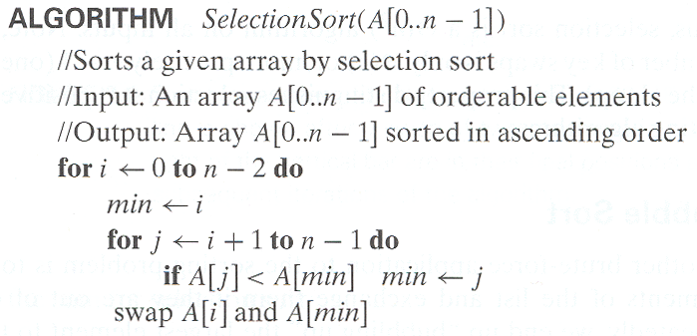
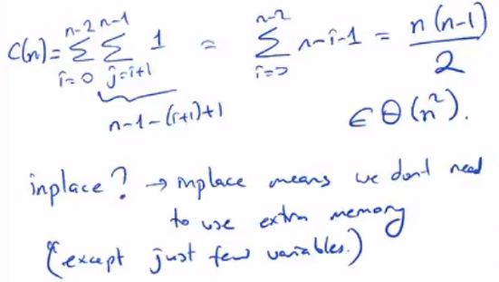
Analysis of Selection Sort
Time efficiency:
Space efficiency:
Stability:
A. Levitin “Introduction to the Design & Analysis of Algorithms,” 3rd ed., Ch. 3 ©2012 Pearson Education, Inc. Upper Saddle River, NJ. All Rights Reserved.

Slide 4
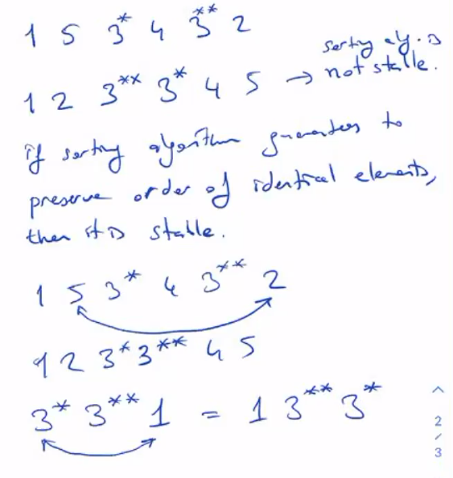
A. Levitin “Introduction to the Design & Analysis of Algorithms,” 3rd ed., Ch. 3 ©2012 Pearson Education, Inc. Upper Saddle River, NJ. All Rights Reserved.

Slide 5
Brute-Force String Matching
pattern: a string of m characters to search for
text: a (longer) string of n characters to search in
problem: find a substring in the text that matches the pattern
Brute-force algorithm
Step 1 Align pattern at beginning of text
Step 2 Moving from left to right, compare each character of
pattern to the corresponding character in text until
    all characters are found to match (successful search); or
    a mismatch is detected
Step 3 While pattern is not found and the text is not yet
exhausted, realign pattern one position to the right and
repeat Step 2
A. Levitin “Introduction to the Design & Analysis of Algorithms,” 3rd ed., Ch. 3 ©2012 Pearson Education, Inc. Upper Saddle River, NJ. All Rights Reserved.

Slide 6


Examples of Brute-Force String Matching
Pattern: 001011
Text: 10010101101001100101111010
Pattern: happy
Text: It is never too late to have a happy childhood.
A. Levitin “Introduction to the Design & Analysis of Algorithms,” 3rd ed., Ch. 3 ©2012 Pearson Education, Inc. Upper Saddle River, NJ. All Rights Reserved.

Slide 7
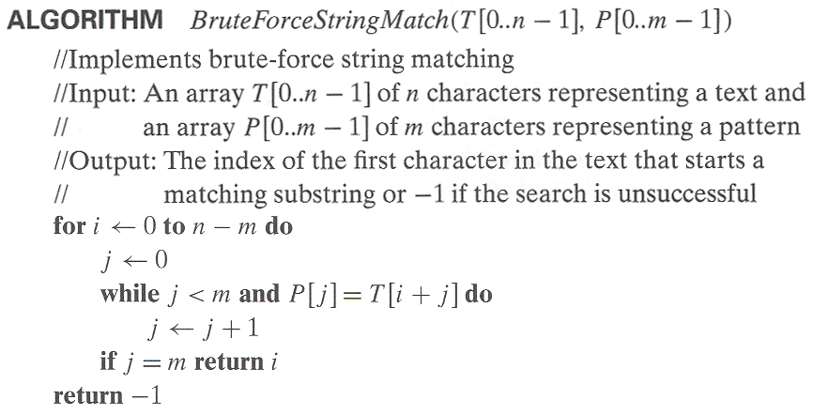
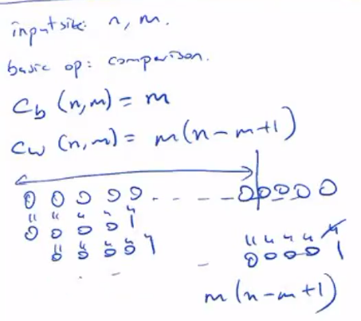
Pseudocode and Efficiency
Efficiency:
A. Levitin “Introduction to the Design & Analysis of Algorithms,” 3rd ed., Ch. 3 ©2012 Pearson Education, Inc. Upper Saddle River, NJ. All Rights Reserved.

Slide 8
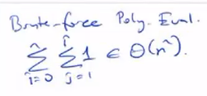
Brute-Force Polynomial Evaluation
Problem: Find the value of polynomial
p(x) = a_{n}x^{n} + a_{n-1}x^{n-1} +… + a₁x¹ + a₀
at a point x = x₀
Brute-force algorithm
Efficiency:
p ← 0.0
for i ← n downto 0 do
power ← 1
  for j ← 1 to i do //compute x^{i}
  power ← power ∗ x
  p ← p + a[i] ∗ power
return p
A. Levitin “Introduction to the Design & Analysis of Algorithms,” 3rd ed., Ch. 3 ©2012 Pearson Education, Inc. Upper Saddle River, NJ. All Rights Reserved.

Slide 9
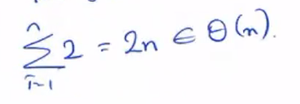
Polynomial Evaluation: Improvement
We can do better by evaluating from right to left:
Better brute-force algorithm
Efficiency:
p ← a[0]
power ← 1
for i ← 1 to n do
    power ← power ∗ x
  p ← p + a[i] ∗ power
  return p
A. Levitin “Introduction to the Design & Analysis of Algorithms,” 3rd ed., Ch. 3 ©2012 Pearson Education, Inc. Upper Saddle River, NJ. All Rights Reserved.

Slide 10
Closest-Pair Problem
Find the two closest points in a set of n points (in the two-dimensional Cartesian plane).
Brute-force algorithm
Compute the distance between every pair of distinct points
and return the indexes of the points for which the distance is the smallest.
A. Levitin “Introduction to the Design & Analysis of Algorithms,” 3rd ed., Ch. 3 ©2012 Pearson Education, Inc. Upper Saddle River, NJ. All Rights Reserved.
Notes:
Draw example.

Slide 11
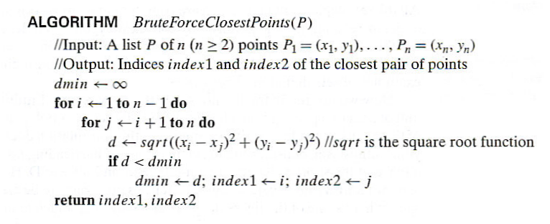
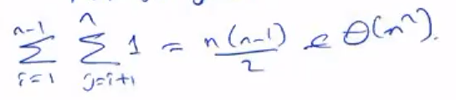
Closest-Pair Brute-Force Algorithm (cont.)
Efficiency:
How to make it faster?
A. Levitin “Introduction to the Design & Analysis of Algorithms,” 3rd ed., Ch. 3 ©2012 Pearson Education, Inc. Upper Saddle River, NJ. All Rights Reserved.
Notes:
The basic operation of the algorithm is computing the Euclidean distance between two points.
The square root is a complex operation who’s result is often irrational, therefore the results
can be found only approximately. Computing such operations are not trivial. One can avoid
computing square roots by comparing distance squares instead.

Slide 12
Brute-Force Strengths and Weaknesses
Strengths
  wide applicability
  simplicity
  yields reasonable algorithms for some important problems
  (e.g., matrix multiplication, sorting, searching, string matching)
Weaknesses
  rarely yields efficient algorithms
  some brute-force algorithms are unacceptably slow
  not as constructive as some other design techniques
A. Levitin “Introduction to the Design & Analysis of Algorithms,” 3rd ed., Ch. 3 ©2012 Pearson Education, Inc. Upper Saddle River, NJ. All Rights Reserved.

Slide 13
Exhaustive Search
A brute force solution to a problem involving search for an element with a special property, usually among combinatorial objects such as permutations, combinations, or subsets of a set.
Method:
  generate a list of all potential solutions to the problem in a systematic manner (see algorithms in Sec. 5.4)
  evaluate potential solutions one by one, disqualifying infeasible ones and, for an optimization problem, keeping track of the best one found so far
  when search ends, announce the solution(s) found
A. Levitin “Introduction to the Design & Analysis of Algorithms,” 3rd ed., Ch. 3 ©2012 Pearson Education, Inc. Upper Saddle River, NJ. All Rights Reserved.

Slide 14
Example 1: Traveling Salesman Problem
Given n cities with known distances between each pair, find the shortest tour that passes through all the cities exactly once before returning to the starting city
Alternatively: Find shortest Hamiltonian circuit in a weighted connected graph
Example:
2
a
b
5
3
8
4
c
d
7
A. Levitin “Introduction to the Design & Analysis of Algorithms,” 3rd ed., Ch. 3 ©2012 Pearson Education, Inc. Upper Saddle River, NJ. All Rights Reserved.

Slide 15
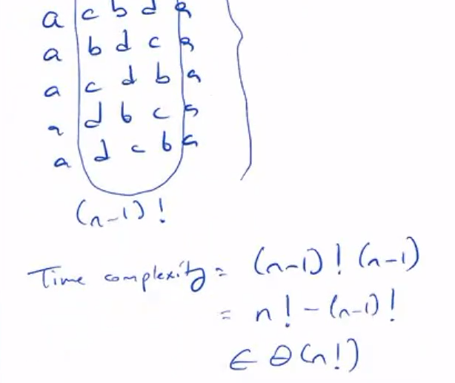
TSP by Exhaustive Search
Tour Cost
a→b→c→d→a 2+3+7+5 = 17
a→b→d→c→a 2+4+7+8 = 21
a→c→b→d→a 8+3+4+5 = 20
a→c→d→b→a 8+7+4+2 = 21
a→d→b→c→a 5+4+3+8 = 20
a→d→c→b→a 5+7+3+2 = 17
More tours?
Less tours?
Efficiency:
A. Levitin “Introduction to the Design & Analysis of Algorithms,” 3rd ed., Ch. 3 ©2012 Pearson Education, Inc. Upper Saddle River, NJ. All Rights Reserved.

Slide 16
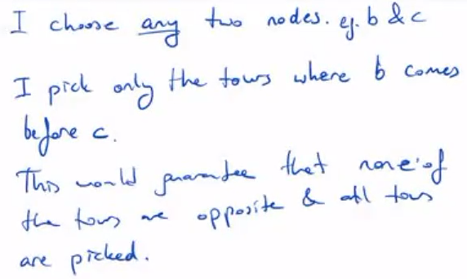
TSP by Exhaustive Search
A. Levitin “Introduction to the Design & Analysis of Algorithms,” 3rd ed., Ch. 3 ©2012 Pearson Education, Inc. Upper Saddle River, NJ. All Rights Reserved.

Slide 17
Example 2: Knapsack Problem
Given n items:
  weights: w₁ w₂ … w_{n}
  values: v₁ v₂ … v_{n}
  a knapsack of capacity W
Find most valuable subset of the items that fit into the knapsack
Example: Knapsack capacity W=16
item weight value
2 $20
5 $30
10 $50
5 $10
A. Levitin “Introduction to the Design & Analysis of Algorithms,” 3rd ed., Ch. 3 ©2012 Pearson Education, Inc. Upper Saddle River, NJ. All Rights Reserved.

Slide 18

Knapsack Problem by Exhaustive Search
Subset Total weight Total value
{1} 2 $20
{2} 5 $30
{3} 10 $50
{4} 5 $10
{1,2} 7 $50
{1,3} 12 $70
{1,4} 7 $30
{2,3} 15 $80
{2,4} 10 $40
{3,4} 15 $60
{1,2,3} 17 not feasible
{1,2,4} 12 $60
{1,3,4} 17 not feasible
{2,3,4} 20 not feasible
{1,2,3,4} 22 not feasible
Efficiency:
A. Levitin “Introduction to the Design & Analysis of Algorithms,” 3rd ed., Ch. 3 ©2012 Pearson Education, Inc. Upper Saddle River, NJ. All Rights Reserved.

Slide 19
Example 3: The Assignment Problem
There are n people who need to be assigned to n jobs, one person per job. The cost of assigning person i to job j is C[i,j]. Find an assignment that minimizes the total cost.
Job 0 Job 1 Job 2 Job 3
Person 0 9 2 7 8
Person 1 6 4 3 7
Person 2 5 8 1 8
Person 3 7 6 9 4
Algorithmic Plan: Generate all legitimate assignments, compute
their costs, and select the cheapest one.
How many assignments are there? n!
Pose the problem as the one about a cost matrix:
A. Levitin “Introduction to the Design & Analysis of Algorithms,” 3rd ed., Ch. 3 ©2012 Pearson Education, Inc. Upper Saddle River, NJ. All Rights Reserved.

Slide 20
Assignment Problem by Exhaustive Search
9 2 7 8
6 4 3 7
5 8 1 8
7 6 9 4
Assignment (col.#s) Total Cost
1, 2, 3, 4 9+4+1+4=18
1, 2, 4, 3 9+4+8+9=30
1, 3, 2, 4 9+3+8+4=24
1, 3, 4, 2 9+3+8+6=26
1, 4, 2, 3 9+7+8+9=33
1, 4, 3, 2 9+7+1+6=23
etc.
(For this particular instance, the optimal assignment can be found by exploiting the specific features of the number given. It is: )
C =
A. Levitin “Introduction to the Design & Analysis of Algorithms,” 3rd ed., Ch. 3 ©2012 Pearson Education, Inc. Upper Saddle River, NJ. All Rights Reserved.

Slide 21
Final Comments on Exhaustive Search
Exhaustive-search algorithms run in a realistic amount of time only on very small instances
In some cases, there are much better alternatives!
  Euler circuits
  shortest paths
  minimum spanning tree
  assignment problem
In many cases, exhaustive search or its variation is the only known way to get exact solution
A. Levitin “Introduction to the Design & Analysis of Algorithms,” 3rd ed., Ch. 3 ©2012 Pearson Education, Inc. Upper Saddle River, NJ. All Rights Reserved.

Slide 22
Graph Traversal Algorithms
Many problems require processing all graph vertices (and edges) in systematic fashion
Graph traversal algorithms:
  Depth-first search (DFS)
  Breadth-first search (BFS)
A. Levitin “Introduction to the Design & Analysis of Algorithms,” 3rd ed., Ch. 3 ©2012 Pearson Education, Inc. Upper Saddle River, NJ. All Rights Reserved.

Slide 23
Depth-First Search (DFS)
Visits graph’s vertices by always moving away from last
visited vertex to unvisited one, backtracks if no adjacent
unvisited vertex is available.
Uses a stack
  a vertex is pushed onto the stack when it’s reached for the first time
  a vertex is popped off the stack when it becomes a dead end, i.e., when there is no adjacent unvisited vertex
“Redraws” graph in tree-like fashion (with tree edges and
back edges for undirected graph)
A. Levitin “Introduction to the Design & Analysis of Algorithms,” 3rd ed., Ch. 3 ©2012 Pearson Education, Inc. Upper Saddle River, NJ. All Rights Reserved.

Slide 24
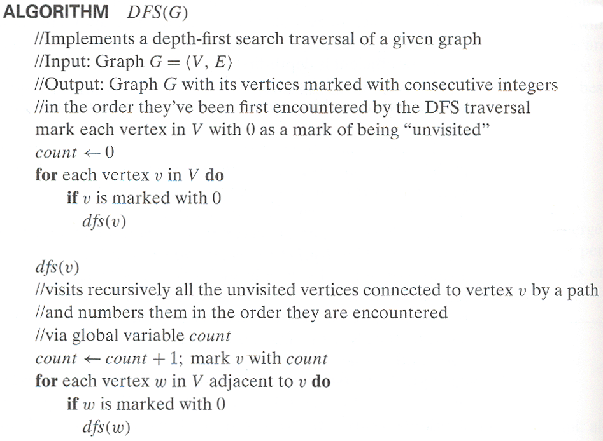
Pseudocode of DFS
A. Levitin “Introduction to the Design & Analysis of Algorithms,” 3rd ed., Ch. 3 ©2012 Pearson Education, Inc. Upper Saddle River, NJ. All Rights Reserved.

Slide 25
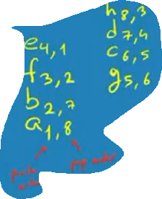
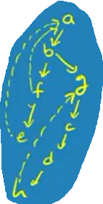
Example: DFS traversal of undirected graph
a
b
c
d
e
f
g
h
DFS traversal stack:
DFS tree:
A. Levitin “Introduction to the Design & Analysis of Algorithms,” 3rd ed., Ch. 3 ©2012 Pearson Education, Inc. Upper Saddle River, NJ. All Rights Reserved.
Notes:
Traversal using alphabetical order of vertices. Work through this example in detail,
showing the traversal by highlighting edges on the graph and showing how the stack
evolves:
8 h 3
7 d 4 stack shown growing upwards
4 e 1 6 c 5 number on left is order that vertex was pushed onto stack
3 f 2 5 g 6 number on right is order that vertex was popped from stack
2 b 7 overlap is because after e, f are popped off stack, g and c
1 a 8 are pushed onto stack in their former locations.
order pushed onto stack: a b f e g c d h
order popped from stack: e f h d c g b a
* show dfs tree as it gets constructed, back edges

Slide 26
Notes on DFS
DFS can be implemented with graphs represented as:
  adjacency matrices: Θ(V²)
  adjacency lists: Θ(|V|+|E|)
Yields two distinct ordering of vertices:
  order in which vertices are first encountered (pushed onto stack)
  order in which vertices become dead-ends (popped off stack)
Applications:
  checking connectivity, finding connected components
  checking acyclicity
  finding articulation points and biconnected components
  searching state-space of problems for solution (AI)
A. Levitin “Introduction to the Design & Analysis of Algorithms,” 3rd ed., Ch. 3 ©2012 Pearson Education, Inc. Upper Saddle River, NJ. All Rights Reserved.

Slide 27
Breadth-first search (BFS)
Visits graph vertices by moving across to all the neighbors of last visited vertex
Instead of a stack, BFS uses a queue
Similar to level-by-level tree traversal
“Redraws” graph in tree-like fashion (with tree edges and cross edges for undirected graph)
A. Levitin “Introduction to the Design & Analysis of Algorithms,” 3rd ed., Ch. 3 ©2012 Pearson Education, Inc. Upper Saddle River, NJ. All Rights Reserved.

Slide 28
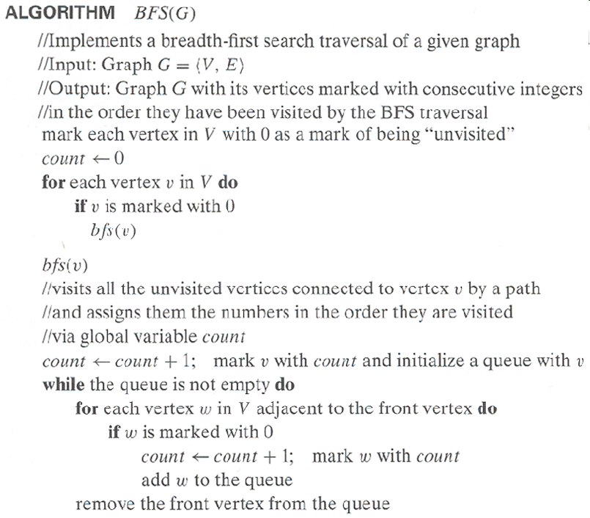
Pseudocode of BFS
A. Levitin “Introduction to the Design & Analysis of Algorithms,” 3rd ed., Ch. 3 ©2012 Pearson Education, Inc. Upper Saddle River, NJ. All Rights Reserved.

Slide 29
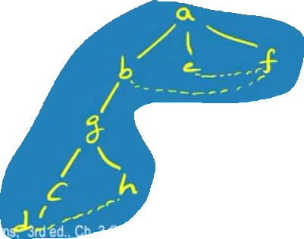
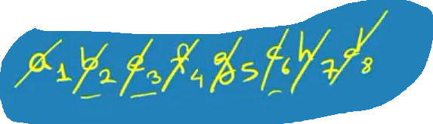
Example of BFS traversal of undirected graph
a
b
c
d
e
f
g
h
BFS traversal queue:
BFS tree:
A. Levitin “Introduction to the Design & Analysis of Algorithms,” 3rd ed., Ch. 3 ©2012 Pearson Education, Inc. Upper Saddle River, NJ. All Rights Reserved.

Slide 30
Notes on BFS
BFS has same efficiency as DFS and can be implemented with graphs represented as:
  adjacency matrices: Θ(V²)
  adjacency lists: Θ(|V|+|E|)
Yields single ordering of vertices (order added/deleted from queue is the same)
Applications: same as DFS, but can also find paths from a vertex to all other vertices with the smallest number of edges
A. Levitin “Introduction to the Design & Analysis of Algorithms,” 3rd ed., Ch. 3 ©2012 Pearson Education, Inc. Upper Saddle River, NJ. All Rights Reserved.

